Slide 1
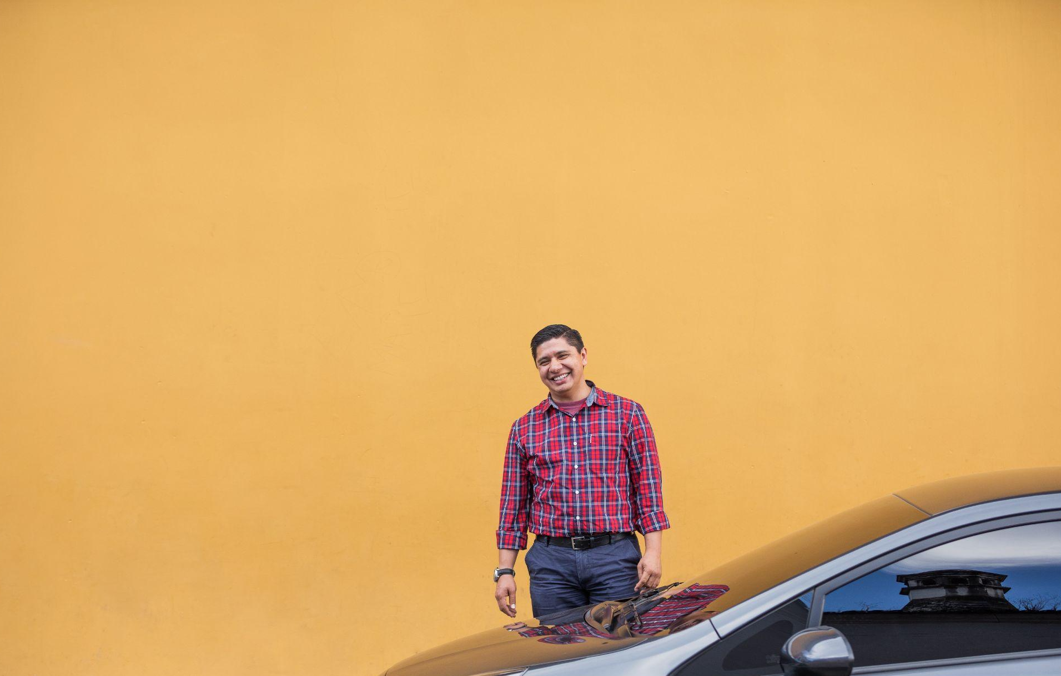

Your guide to driving with Uber in Poland
Earn whenever you want
The following presentation shall not be considered as a legal or tax advice, only a summary of some practical information that might be useful for you. You as an independent contractor shall be solely responsible for your actions / investments and legal / tax affairs.

Slide 2
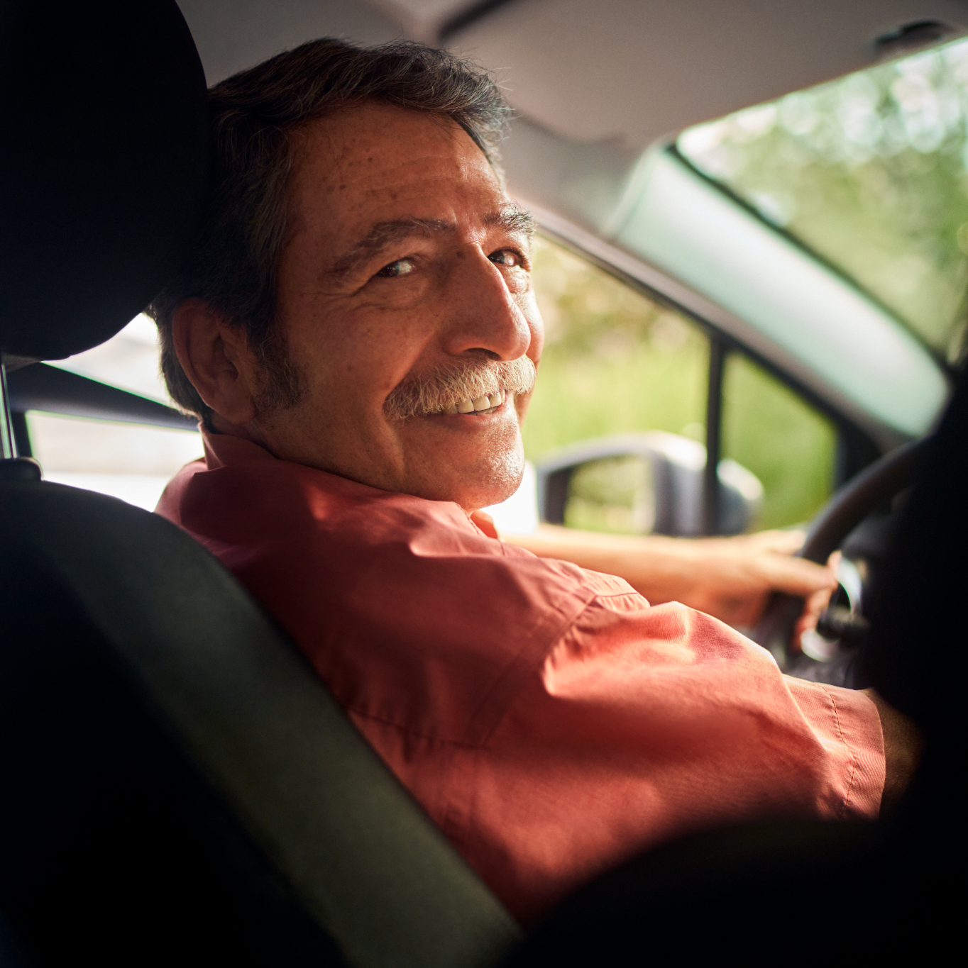
| Welcome to the Uber Driver app
How nice that you are interested in driving via the Uber platform! We are happy to help you on your way.
Check whether you meet the requirements below to get started.
The basics
Do you meet these minimum requirements for the Uber platform? Then you can most likely get started as soon as you have the right papers!
18 years or older
Polish driving license
ID document/passport/residence permit (with the note ‘Access to the labour market’)
Criminal certificate from court
Valid psychological and medical checks
Taxi identificator (if applicable)

Slide 3
| How do you want to start with Uber?
If you already have all the necessary documents, it will only take few days before you are active on the Uber platform >> Go to page 18 here
Drive under a fleet partner
Advantages:
Only personal documents required
Drive someone else’s vehicle or in your own
Payment options via your fleet partner (e.g. salary or fixed fee)
What do you need?
Fleet partner with taxi permit and vehicle
Polish driving license
ID document/passport/residence permit (with the note ‘Access to the labour market’)
Criminal record document
Start as independent driver
Advantages:
Choose when and where you want to drive
Arrange your own vehicle
Only pay commission on the trips you completed
What do you need?
Taxi license and own company
Business document and bank statement
Own vehicle
ID document/passport/residence permit (with the note ‘Access to the labour market’)
Polish driving license
Criminal record document
Start as fleet partner
Advantages:
Own fleet of vehicles
Pay commission on trips made and arrange payment yourself with your drivers
What do you need?
Taxi license and own company
Business document and bank statement
Own vehicle
ID document/passport/residence permit (with the note ‘Access to the labour market’)
Polish driving license (In case you want to drive)
Criminal record document (in case you want to drive)

Slide 4

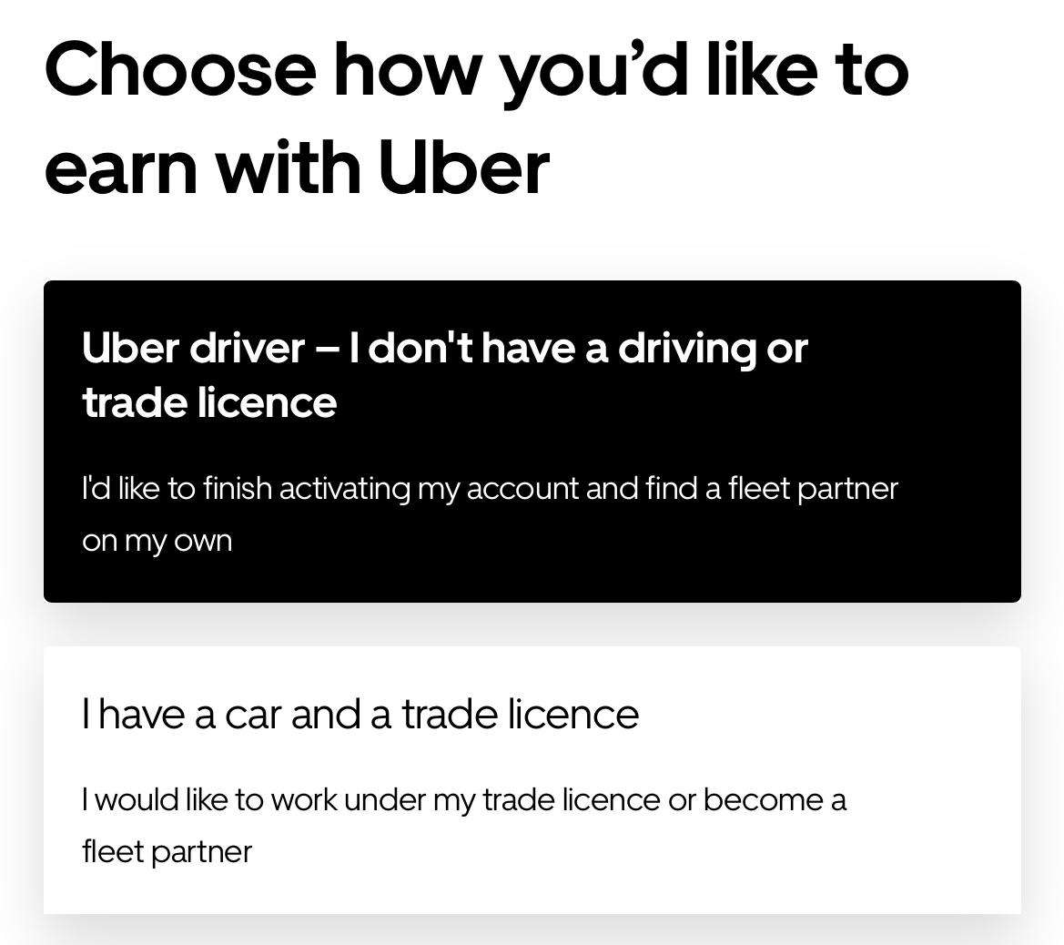
| Drive under a fleet partner
Drive under a fleet partner
Personal checklist
Step 1 - Sign up
Download the Uber Driver App
Sign up via the Uber Driver App
Step 2 - Documents
ID document
Polish driving license
Criminal record document
Medical and psychological check
Step 3 - Find a fleet partner
Find a fleet partner with vehicle
Step 4 - Driver in-person verification (DIPV)
Book an appointment in DIPV office for personal verification
Bring your documents physically with you
Step 5 - Upload the rest of your documents & connect with a fleet partner
Upload your documents
Connect with a fleet partner
Fleet Partners are business owners who, once registered as an Uber partner, can make their fleet available to multiple other drivers. They own the taxi license and a vehicles that you can use and you make agreements with your fleet partner on how you will paid (e.g. salary, commission, rental of the vehicle)
We will help you get started in this guide. Use the checklist on the right to check whether you have completed all steps!
I Step 1 - Sign up with Uber
In case you didn’t do it yet - download the
Uber Driver App via your phone or create your
own profile via your computer
Select ‘I don’t have a driving or trade licence’ and start uploading
your docs!

Slide 5
Drive under a fleet partner
I Step 2 - Prepare your documents
Time to upload all necessary documents to become active as a driver under a fleet partner in Poland. You will need following documents:
- ID document/Passport/Residence permit (with the note ‘Access to the labour market’)
- Polish driving license in this blog you can find information how you can change your driver license
- Criminal record document (issued no longer than 30 days before you come for verification)
- Medical and psychological checks
I Step 3 - Find a fleet partner
To be able to drive via the Uber platform, you need a fleet partner with a valid taxi license.
Find a fleet partner
You may already know a fleet partner that you would like to join. Not yet? Via this link you will find an overview of the fleet partners that have indicated to Uber that they are still looking for new drivers
Please note: Only once you uploaded all your documents and completed the personal verification, you can link your account to a fleet partner (see step 5).
I Step 4 - Driver in person verification
Finished all the steps above? Time for your personal verification.
Book an appointment via App or website and go to the verification office with your physical ID document, driver’s license and criminal record document all physically(issued no longer than 30 days before you come for verification).
During the verification, our agents will make you a profile picture on special Uber’s background.
After your successful verification you are ready to take step 5
Issues? Contact support

Slide 6
Drive under a fleet partner
You’re almost there… final steps
I Step 5 - Upload your documents & Connect with a fleet partner
If you haven’t done it before it is time to upload your documents via your Uber profile via the Uber Driver App or on your computer. In your Uber Driver App you can find an overview of your documents with instructions on how to upload them.
In case you didn’t already do so, upload the following documents to complete your profile:
ID document/Passport/Residence permit (with the note ‘Access to the labour market’)
Polish driving license in this blog you can find information how you can change your driver license
Criminal record document
Medical check
Psychological check
Complete the virtual info session via the Uber Driver App so you know exactly how the Uber Driver App works
Link your account to a fleet partner
Provide your email address and telephone number to your new fleet partner
Your fleet partner adds your data to their Uber Supplier Portal dashboard
Confirm your connection via the Uber Driver App
Everything completed? Connected to a fleet partner?
Please note: It takes a maximum of 48 hours to fully check your account and activate, so you can start taking trips.
I Step 6 - Complete your first trip
If everything has been received and checked, your account will be automatically activated.
YES! Welcome to the Uber Driver App - we can't wait to see you on the road! 🚗
Issues? Contact support

Slide 7
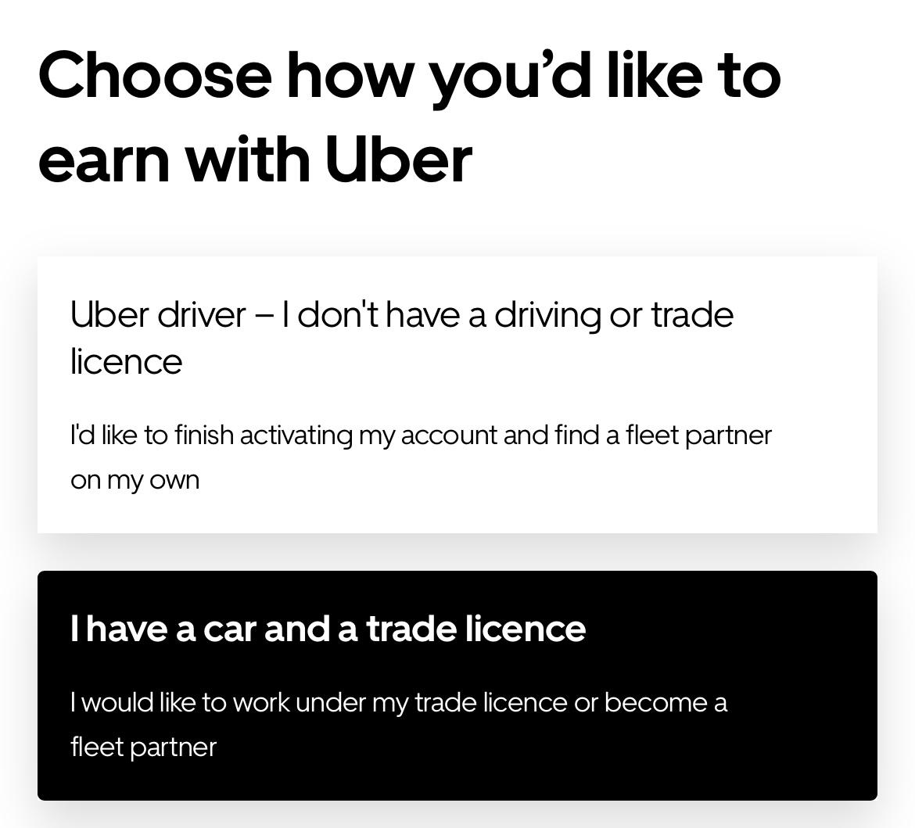
| Start as independent driver
Start as independent driver
Personal checklist
Step 1 - Sign up
Download the Uber Driver App
Sign up via the Uber Driver App
Step 2 - Documents
ID document/Passport/Residence permit
Polish driving license
Criminal record document
Medical and psychological check
Excerpt from the business document(CEIDG/KRS)
Taxi license from your company
Bank statement
Step 3 - Vehicles
Arrange a vehicle
Arrange insurance for your vehicle
Arrange a excerpt from your taxi license for your vehicle
Arrange a photo of the licensed car with all necessary taxi signs (according to loca taxi law)
Step 4 - Driver in-person verification (DIPV)
Book an appointment in DIPV office for personal verification
Bring your documents physically with you
Step 5 - Upload the rest of your documents and informations via the Uber app
We will help you get started in this guide. Use the checklist on the right to check whether you have completed all steps!
I Step 1 - Sign up with Uber
In case you didn’t do it yet - download the Uber Driver App via your phone or create your own profile via your computer.
Select ‘I have a car and a trade licence’ and start uploading
your docs!

Slide 8
Start as independent driver
I Step 2 - Request your documents
Apart from your personal documents, ID document, driver’s license, criminal record document you will need to have some more documents. In order to become active as a independent taxi driver in Poland you will have to apply for the necessary additional documents. You will need to own a company and acquire taxi license for it.
Please note: We recommend that you apply for the different documents at the same time, so that you can get on the road faster!
| Create a company
1.In order to become an independent driver Uber require you to create your own company. As Uber we leave you the decision what kind of company you want to create. According to the polish law there are two types of companies you may choose from:
- personal company (CEIDG registry),
- incorporated company (KRS registry)
Uber recommends you to consult your business decision with the professional as Uber doesn’t provide law or tax advices.
However when registering a company, select the PKD code 49.32.Z (personal taxi operations).
2. Apply for taxi license for your company
Follow the steps in this document
| Apply for a taxi license for your company
Accomplish following steps:
  own a car
  make medical and psychological checks
  collect criminal history document from district court
  equip your car with necessary taxi elements
  reach out to any district inspection station for taxi check-up of your car
  receive the taxi stamp in your car’s registration document from the vehicle’s registration office
Apply for a taxi license for your company at the local City Hall’s taxi license department - more information here
Await for your taxi license for your company
Please note: This process may take up to 2-4 weeks.
Receive your taxi license
Have you received all the above documents?
Issues? Contact support

Slide 9
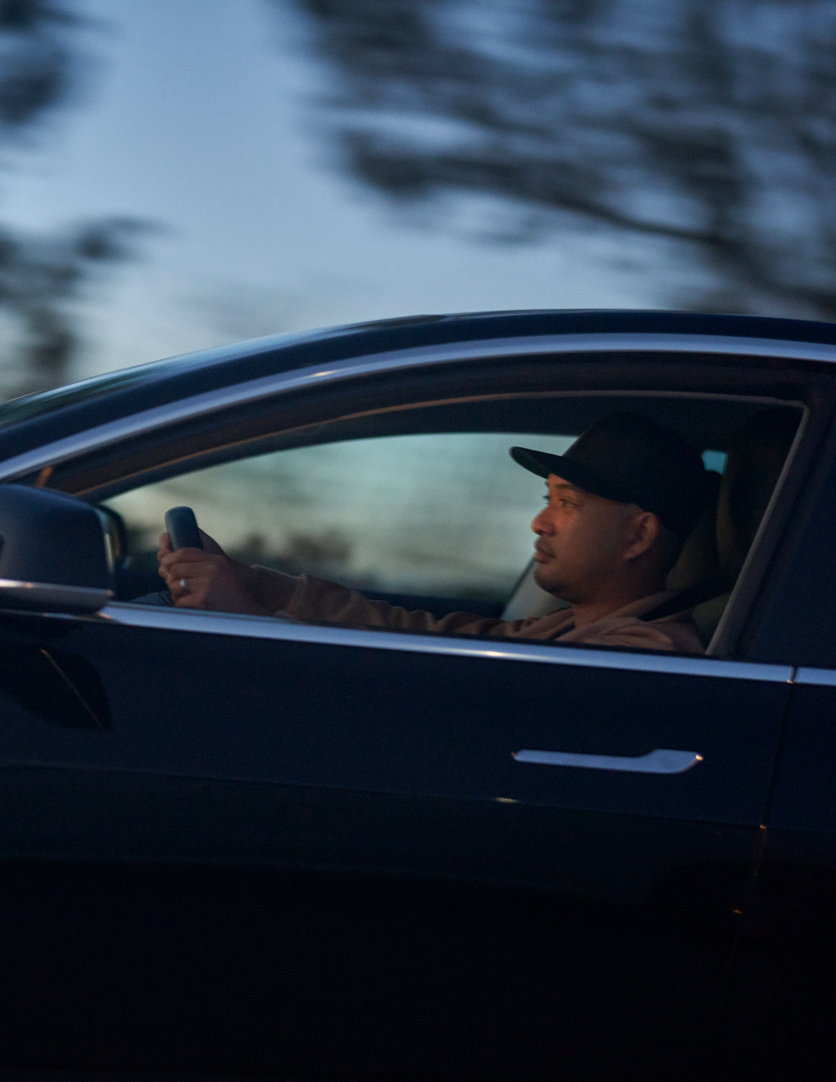
Start as independent driver
I Step 3 - Arrange a vehicle
Which vehicle will you use for your first trip with the Uber app? Check what additional steps you need to take.
Find a vehicle - find an overview of vehicle requirements here
Buy a vehicle
Lease a vehicle - Choose a full lease (operational lease) or financial lease if you want to own the vehicle at the end of the lease period.
Rent a vehicle
Insure your vehicle
Make sure your vehicle is properly insured and have proof of this insurance. Do you lease a vehicle? Check whether it is part of your contract.
Equip a vehicle with taxi signage and a taxi lamp (according to the local taxi law)
In Poland, every taxi is required to be equipped according to the country’s taxi law and also local taxi law. For more information you can reach out to the local City Hall’s office or find out more here.
Visit district inspection station for taxi check-up of your car
During taxi check-up your vehicle will be checked if all taxi requirements are met. If inspection is successful, you will get taxi certificate document.
Visit vehicle’s registration office
Visit vehicle’s registration office with taxi certificate document in order to receive taxi stamp in your car’s registration document. Remember that the appropriate office is the office that is mentioned in car’s registration document.
Issues? Contact support

Slide 10
Start as independent driver
You’re almost there… final steps
IStep 4 - Driver in-person verification
Finished all the steps above? Time for your personal verification.
Book an appointment via App or website and go to the verification office with your ID document, driver’s license and criminal record document all physically (issued no longer than 30 days before you come for verification).
During the verification, our agents will make you a profile picture on special Uber’s background!
I Step 6 - Complete your first trip
If everything has been received and checked, your account will be automatically activated.
YES! Welcome to the Uber App - we can't wait to see you on the road! 🚗
IStep 5 - Upload your documents
Have you received your final documents? Then it is time to upload them via your Uber profile via the App or on your computer. In your app you can find an overview of your documents with instructions on how to upload them.
In case you didn’t already do so, upload the following documents to complete your profile:
Profile picture
ID document/Passport/Residence permit (with the note ‘Access to the labour market’)
Criminal record document
Polish driving license in this blog you can find information how you can change your driver license
Taxi license document
Bank statement
Company document (CEIDG/KRS)
ID card of a person who has more than 25% in the company
Identity card of a board member
Everything complete?
Fill in your tax information via the Uber Driver App or via supplier.uber.com.
Fill in your bank account number in the Vault in the Uber Driver App or via supplier.uber.com.
Please note: It takes a maximum of 2 days to fully check your account and activate, so you can start taking trips.
Issues? Contact support

Slide 11
| Overview timing and costs
Start as independent driver
Week 1 & 2
Upfront investment: ~ 222 PLN-920 PLN
Week 3
Upfront investment: ~ 400 PLN +
Monthly ~. 100 PLN - 300 PLN
- Per vehicle
Week 4-12
Upfront investment: 0 PLN
Sign up via Uber
Register a personal company 0 PLN / incorporated company 600PLN
Request taxi license
~ 200PLN-320PLN |2- 4 weeks
Request taxi license excerpt on car
22 PLN - 35.2PLN
Car’s taxi stickers and taxi lamp ~300 PLN-400 PLN
Arrange vehicle & insurance
~ 100 PLN - 300 PLN monthly
Upload your documents
Complete the Driver in-person verification
Week 4-12
Go online
🚗🚗🚗
Issues? Contact support

Slide 12
| Start as fleet partner
Start as fleet partner
Personal checklist
Step 1 - Sign up
Download the Uber Driver App
Sign up via the Uber Driver App
Step 2 - Documents
ID document/Passport/Residence permit
Criminal record document
Medical and psychological check
Excerpt from the business document(CEIDG/KRS)
Taxi license from your company
Bank statement
Polish driving license
Note: only if you want to be also driver
Step 3 - Vehicles
Arrange a vehicle
Arrange insurance for your vehicle
Arrange a excerpt from your taxi license for your vehicle
Arrange a photo of the licensed car with all necessary taxi signs (according to local taxi law)
Step 4 - Driver in-person verification if you want to be also a driver(DIPV)
Book an appointment in DIPV office for personal verification
Bring your documents physically with you
Step 5 - Upload the rest of your documents and informations via the Uber app
Fleet Partners are business owners who, once registered as an Uber partner, can make their fleet available to multiple other drivers.
We will help you get started in this guide. Use the checklist on the right to check whether you have
completed all steps!
I Step 1 - Sign up with Uber
In case you didn’t do it yet - download the Uber Driver App via your phone or create your own profile via your computer Select ‘I have a car and a trane licence’ and start uploading
your docs!.

Slide 13
Start as fleet partner
I Step 2 - Request your documents
Apart from your personal documents, ID document, driver’s license, criminal record document you will need to have some more documents. In order to become active as a independent taxi driver in Poland you will have to apply for the necessary additional documents. You will need to own a company and acquire taxi license for it.
Please note: We recommend that you apply for the different documents at the same time, so that you can get on the road faster!
| Create a company
1. .In order to become an independent driver Uber require you to create your own company. As Uber we leave you the decision what kind of company you want to create. According to the polish law there are two types of companies you may choose from:
- personal company (CEIDG registry),
- incorporated company (KRS registry)
Uber recommends you to consult your business decision with the professional as Uber doesn’t provide law or tax advices.
However when registering a company, select the PKD code 49.32.Z (personal taxi operations).
2. Apply for taxi license for your company
Follow the steps in this document
| Apply for a taxi license for your company
Accomplish following steps:
  own a car
  make medical and psychological checks
  collect criminal history document from district court
  equip your car with necessary taxi elements
  reach out to any district inspection station for taxi check-up of your car
  receive the taxi stamp in your car’s registration document from the vehicle’s registration office
Apply for a taxi license for your company at the local City Hall’s taxi license department - more information here
Await for your taxi license for your company
Please note: This process may take up to 2-4 weeks.
Receive your taxi license
Have you received all the above documents?
Issues? Contact support

Slide 14
Start as fleet partner
I Step 3 - Arrange a vehicle
Which vehicle will you use for your first trip with the Uber app? Check what additional steps you need to take.
Find a vehicle - find an overview of vehicle requirements here
Buy a vehicle
Lease a vehicle - Choose a full lease (operational lease) or financial lease if you want to own the vehicle at the end of the lease period.
Rent a vehicle
Insure your vehicle
Make sure your vehicle is properly insured and have proof of this insurance. Do you lease a vehicle? Check whether it is part of your contract.
Equip a vehicle with taxi signage and a taxi lamp (according to the local taxi law)
In Poland, every taxi is required to be equipped according to the country’s taxi law and also local taxi law. For more information you can reach out to the local City Hall’s office or find out more here.
Visit district inspection station for taxi check-up of your car
During taxi check-up your vehicle will be checked if all taxi requirements are met. If inspection is successful, you will get taxi certificate document.
Visit vehicle’s registration office
Visit vehicle’s registration office with taxi certificate document in order to receive taxi stamp in your car’s registration document. Remember that the appropriate office is the office that is mentioned in car’s registration document.
Issues? Contact support

Slide 15
Start as fleet partner
You’re almost there… final steps
IStep 4 - Driver in-person verification
Finished all the steps above? Time for your personal verification.
Book an appointment via App or website and go to the verification office with your ID document, driver’s license and criminal record document all physically(issued no longer than 30 days before you come for verification).
During the verification, our agents will make you a profile picture on special Uber’s background.!
Note: This step is required only if you want to be also a driver
I Step 6 - Complete your first trip
If everything has been received and checked, your account will be automatically activated.
YES! Welcome to the Uber App - we can't wait to see you on the road! 🚗
IStep 5 - Upload your documents
Have you received your final documents?
Then it is time to upload them via your Uber profile via the App or on your computer.
In your app you can find an overview of your documents with instructions on how to upload them.
In case you didn’t already do so, upload the following documents to complete your profile:
Profile picture
ID document/Passport/Residence permit (with the note ‘Access to the labour market’)
Taxi license document
Bank statement
Company document (CEIDG/KRS)
Criminal record document&Polish driving license in this blog you can find information how you can change your driver license
Note: only if you want to be also driver
Everything complete?
Fill in your tax information via the Uber Driver App or via supplier.uber.com.
Fill in your bank account number in the Vault in the Uber Driver App or via supplier.uber.com.
Please note: It takes a maximum of 2 days to fully check your account and activate, so you can start taking trips.
Issues? Contact support

Slide 16
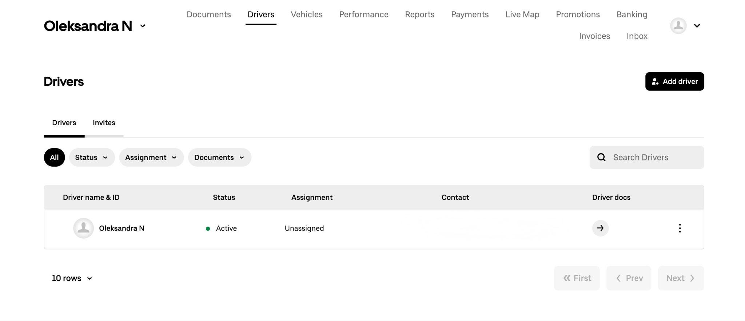
Start as fleet partner
As soon as you are online as a Fleet partner on the Uber platform, you can immediately manage your fleet online via the Supplier portal
Where can you use the supplier portal for?
Insight into documents of your fleet, drivers and vehicles
Insight into the finances and performance of your fleet
Easily add drivers to your fleet
Easily check the driver's and vehicle's status
Help drivers with onboarding
I Step 7 - Manage your fleet
Issues? Contact support

Slide 17
| Overview timing and costs
Start as fleet partner
Week 1 & 2
Upfront investment: ~ 222 PLN-920 PLN
Week 3
Upfront investment: ~ 400 PLN +
Monthly ~. 100 PLN - 300 PLN
- Per vehicle
Week 4-12
Upfront investment: 0 PLN
Sign up via Uber
Register a personal company 0 PLN / incorporated company 600PLN
Request taxi license
~ 200PLN-320PLN 2- 4 weeks
Request taxi license excerpt on car
22 PLN - 35.2PLN
Car’s taxi stickers and taxi lamp ~300 PLN-400 PLN
Arrange vehicle & insurance
~ 100 PLN - 300 PLN monthly
Upload your documents
Complete the Driver in-person verification if applicable
Week 4-12
Go online with your fleet
🚗🚗🚗
Issues? Contact support

Slide 18
Ready to drive!
I Summary: Do you already have all your documents?
Great that you already have all your documents complete! See below for a brief overview to get started as quickly as possible:
| Step 1 - Sign up via Uber (download the Uber Driver App)
| Step 2 - Upload your documents & complete the online course
I Drive under a fleet partner
Polish driving license
ID document/passport/residence permit (with the note ‘Access to the labour market’)
Criminal record document
DIPV’s process completed
Medical check and psychological check
Fleet partner with taxi license and a vehicle
I Start as an independent driver
ID document/passport/residence permit (with the note ‘Access to the labour market’)
Polish driving license
Criminal record document
Medical and psychological check
Business document (CEIDG/KRS)
Taxi license
Bank statement
Vehicle registration certificate (front- and back)
Proof of insurance
I Start as fleet partner
ID document/passport/residence permit (with the note ‘Access to the labour market’)
Business document(CEIDG/KRS)
Taxi license
Bank statement
Vehicle registration certificate (front- and back)
Proof of insurance
Criminal record document,Medical and psychological check&Polish driving license if you want also to be a driver
Issues? Contact support

Slide 19
Ready to drive!
| Step 3 - Go online and complete your first trip
If everything has been received and checked, your account will be automatically activated.
YES! Welcome to the Uber App - we can't wait to see you or your fleet on the road! 🚗
Do you need help with finding a vehicle or are you looking for a fleet partner. We’d love to help you!
Helpful links :
Requirements for drivers: t.uber.com/requirements
How to become a partner: t.uber.com/zostan-partnerem
List of recommended partners by drivers: t.uber.com/ListaPartnerow
Requirements for cars: t.uber.com/pojazdy
How the car must be marked: uber.com/pl/blog/zdjecie-pojazdu/
Issues? Contact support

Slide 20
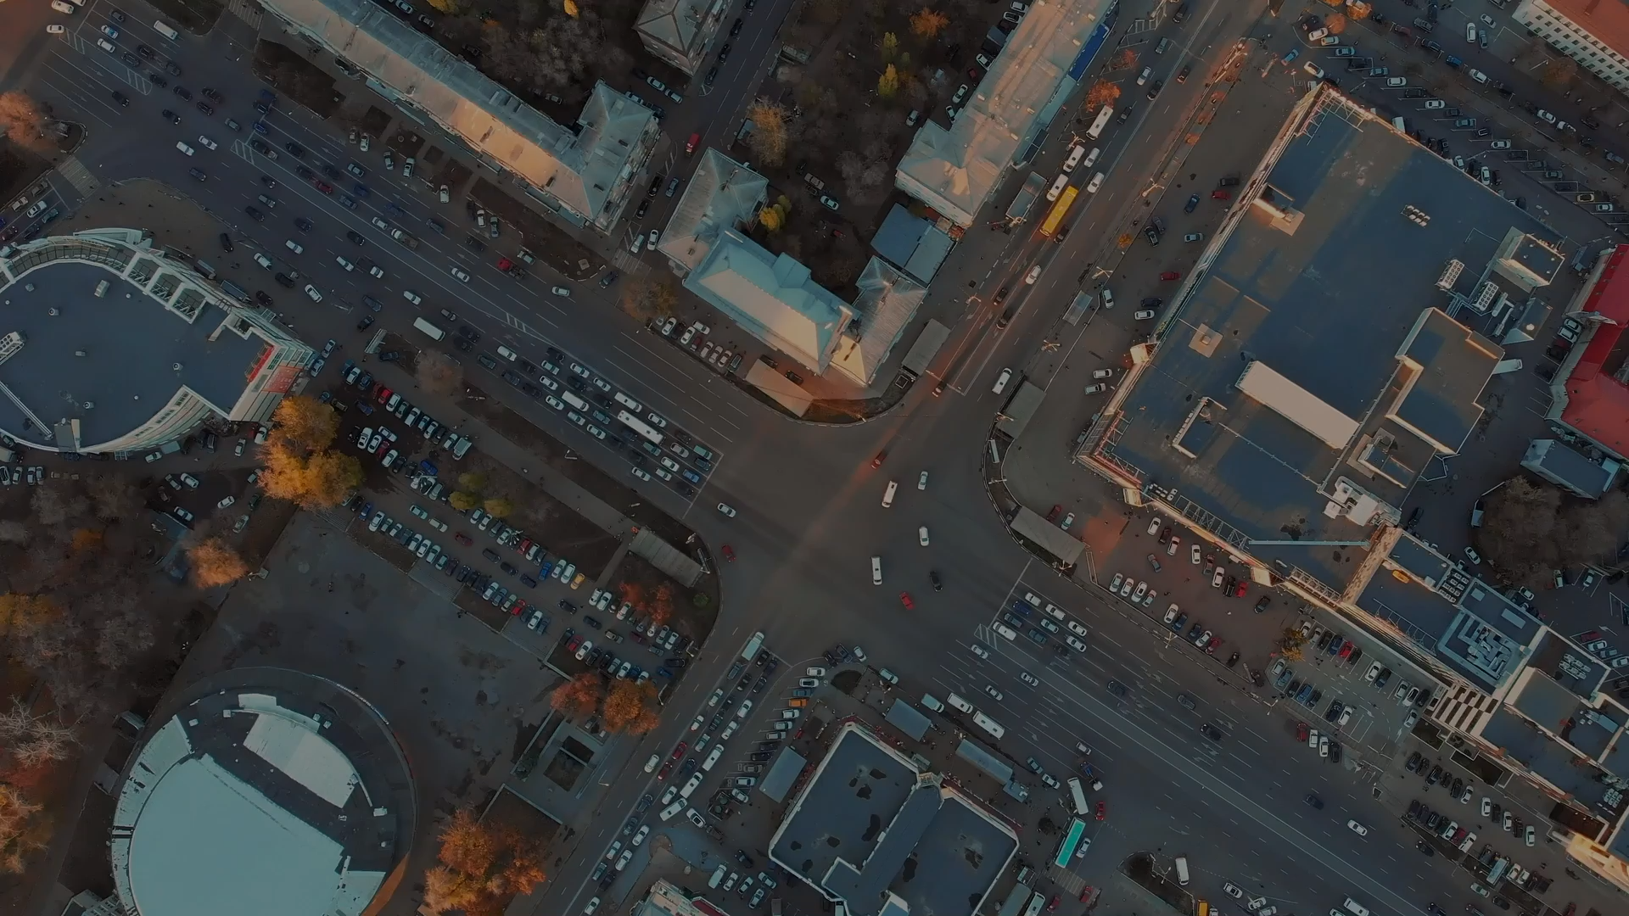
Questions? We’d love to help you get on the road
Have a look at the FAQ, send in a ticket or book a (video) appointment for personal support

